Slide 1
UNIT–II
Computer-based Symmetric Key Cryptographic Algorithms:
Algorithm Types and Modes, An overview of Symmetric Key Cryptography, DES, International Data Encryption Algorithm (IDEA), RC5, Blowfish, AES, Differential and Linear Cryptanalysis

Slide 2
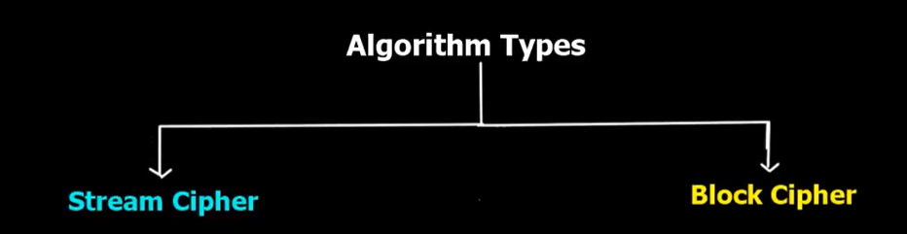
Algorithm Types

Slide 3
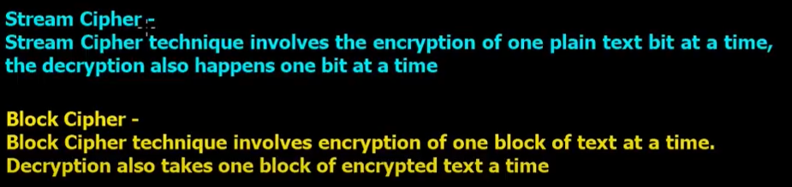
Algorithm Types

Slide 4
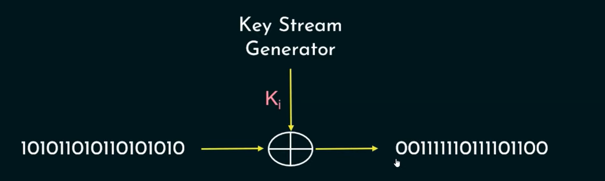
Stream cipher

Slide 5
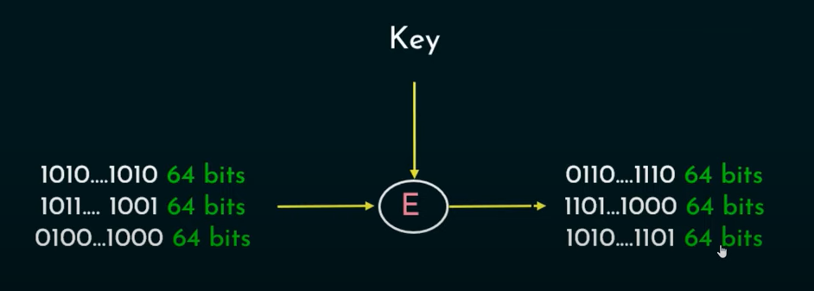
Block cipher

Slide 6
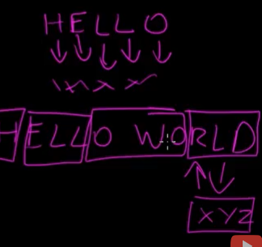
Algorithm Types

Slide 7
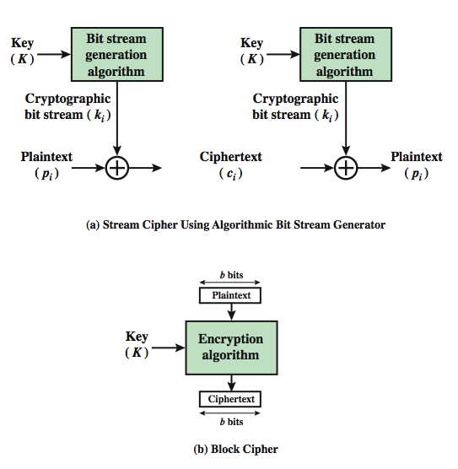
Block cipher VS Stream cipher

Slide 8
Algorithm Types
There are two basic types of symmetric algorithms: block ciphers and stream ciphers.
Block ciphers operate on blocks of plaintext and cipher text—usually of 64 bits but sometimes longer.
Stream ciphers operate on streams of plaintext and cipher text one bit or byte (sometimes even one 32-bit word) at a time.
With a block cipher, the same plaintext block will always encrypt to the same cipher text block, using the same key. With a stream cipher, the same plaintext bit or byte will encrypt to a different bit or byte every time it is encrypted.

Slide 9
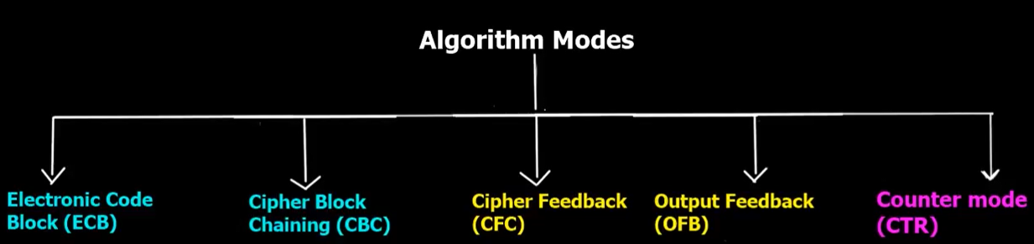
Algorithm Modes

Slide 10
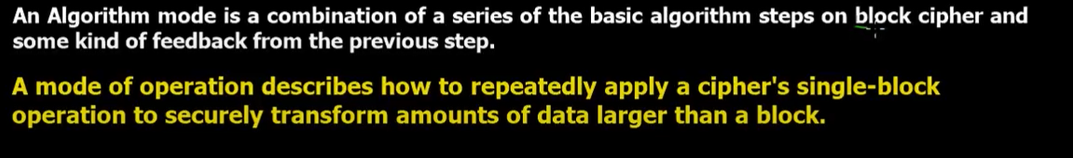
Algorithm Modes

Slide 11
Electronic code book (ECB)
Simplest mode of operation.
Plain text message is divided into blocks of 64 bits each.
Each block then encrypted independently of the other blocks.
For each blocks same key used for encryption
ECB is useful only for small message.
Characteristics of ECB
The same b bit block of plaintext , if it appears more than once in message , always produce the same cipher text.

Slide 12
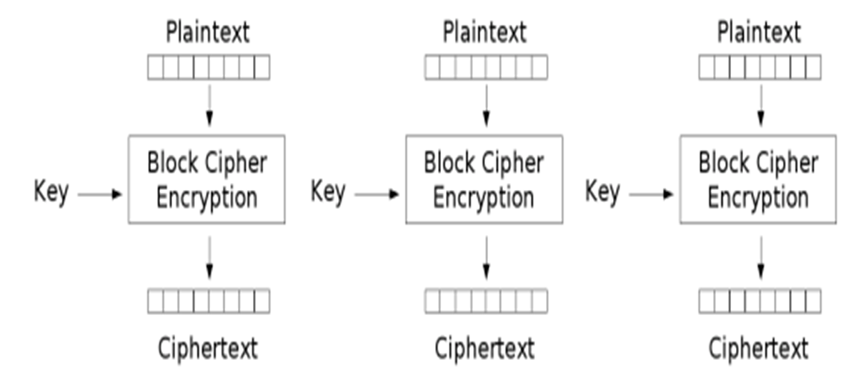
Electronic code book (ECB)

Slide 13
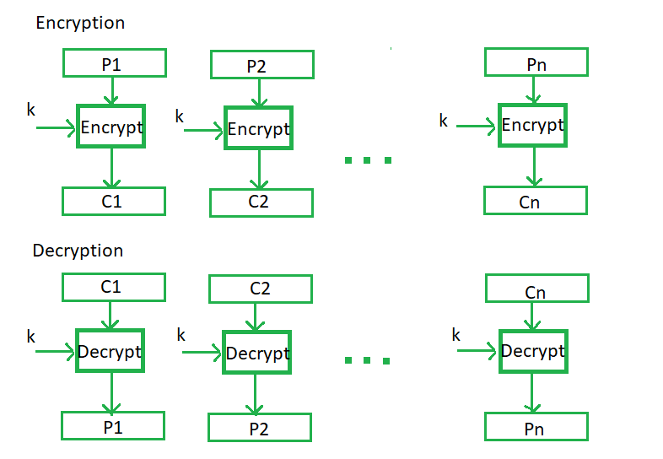
Electronic code book (ECB)

Slide 14
Cipher Block Chaining (CBC)
In Cipher Block Chaining (CBC) message is broken into blocks linked together in encryption operation each previous cipher blocks is chained with current plaintext block, hence name use Initial Vector (IV) to start process
uses: bulk data encryption, authentication

Slide 15
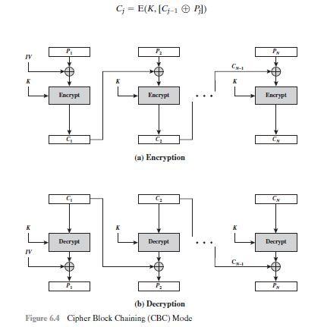
Cipher Block Chaining (CBC)

Slide 16
Cipher feedback mode(CFB)
In cryptography, cipher text feedback (CFB), also known as cipher feedback, is a mode of operation for a block cipher.
Cipher text feedback uses an initialization vector (IV). CFB uses a block cipher as a component of a random number generator. In CFB mode, the previous ciphertext block is encrypted and the output is XORed with the current plaintext block to create the current cipher text block. The XOR operation conceals plaintext patterns.

Slide 17
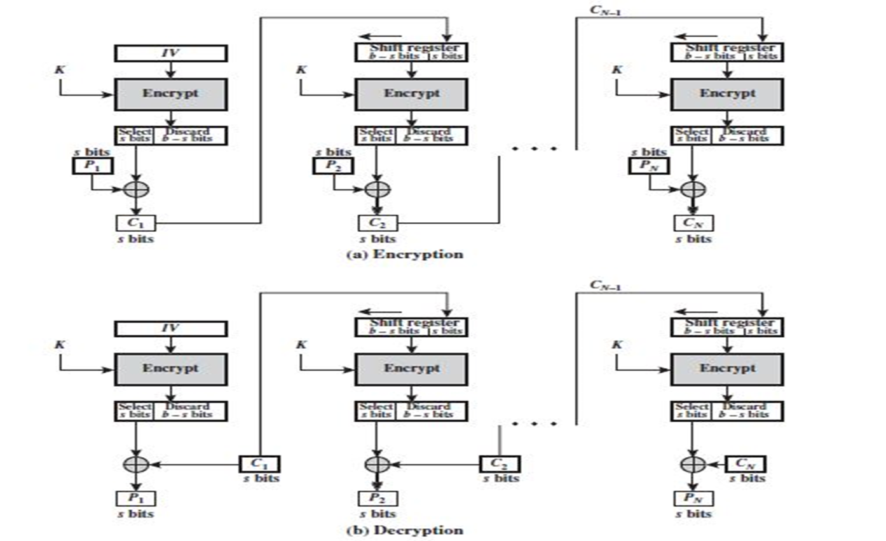
Cipher feedback mode(CFB)

Slide 18
Cipher feedback mode(CFB)
C1 = P1 (XOR) MSBs [E(k,IV)].
P1 = C1 (XOR) MSBs [E(k,IV)].
For DES, b = 64 bits.
For AES, b = 128 bits.
Initially S = 8 bits.

Slide 19
Output feedback mode(OFB)
The output feedback mode follows nearly the same process as the Cipher Feedback mode except that it sends the encrypted output as feedback instead of the actual cipher which is XOR output.
In output feedback mode, all bits of the block are sent instead of sending selected s bits. The Output Feedback mode of block cipher holds great resistance towards bit transmission errors. It also decreases the dependency or relationship of the cipher on the plaintext.

Slide 20
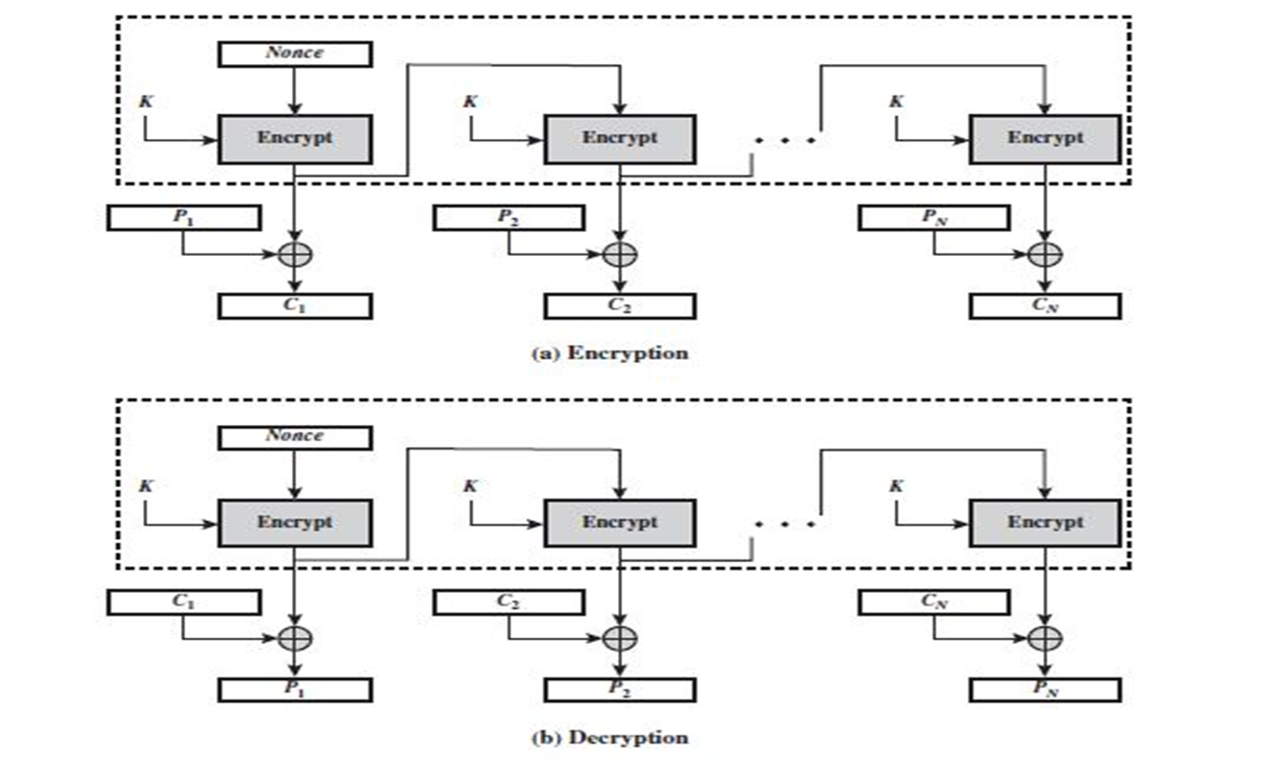
Output feedback mode(OFB)

Slide 21
Output feedback mode(OFB)
The Counter Mode or CTR is a simple counter-based block cipher implementation. Every time a counter-initiated value is encrypted and given as input to XOR with plaintext which results in cipher text block. The CTR mode is independent of feedback use and thus can be implemented in parallel.
Extremely similar to the CFB.
Only difference is that in the case of OFB, the output of the IV encryption process is fed into the next stage of encryption process

Slide 22
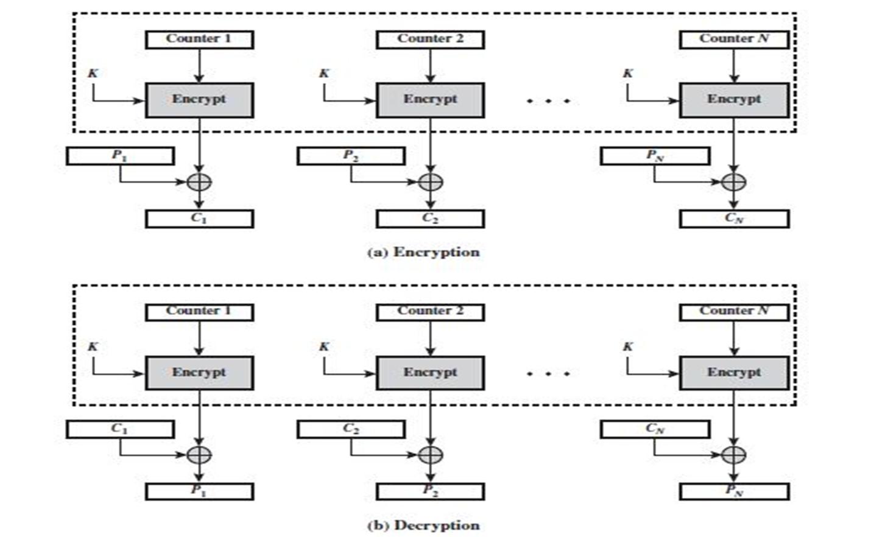
Counter Mode(CTR)

Slide 23
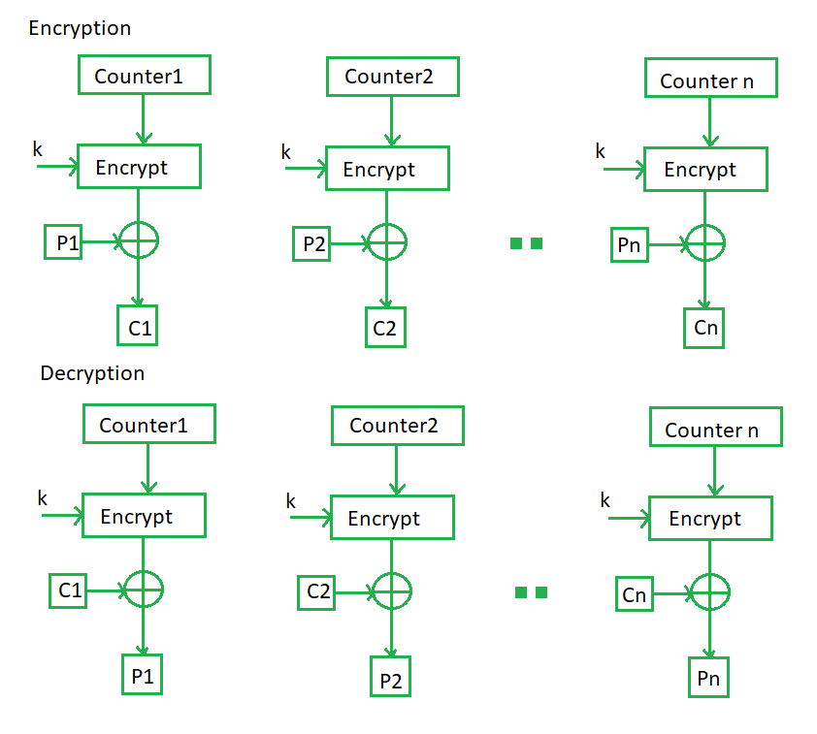
Counter Mode(CTR)

Slide 24
Counter Mode(CTR)
Similar to the OFB with one variation.
It uses sequence number called counters as the input to the algorithm.
After each block is encrypted to fill the register, the next counter value is used.
Size of counter value is same as plain text block.

Slide 25
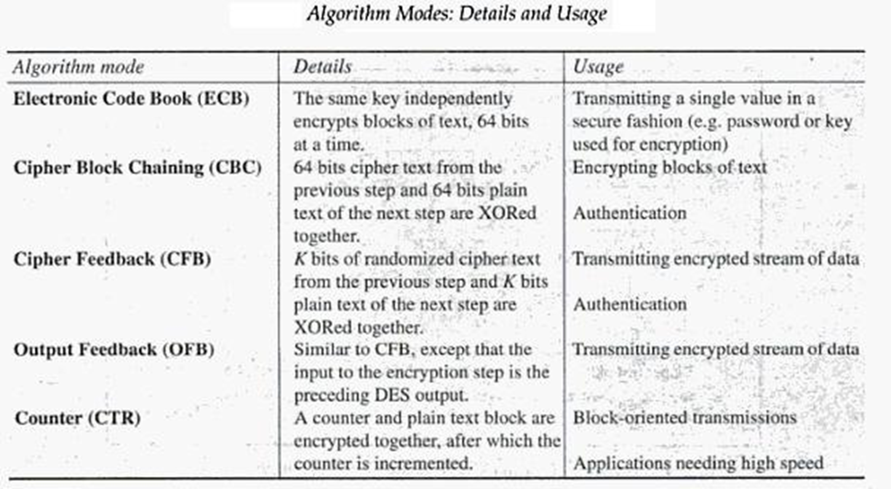
Algorithm Modes

Slide 26
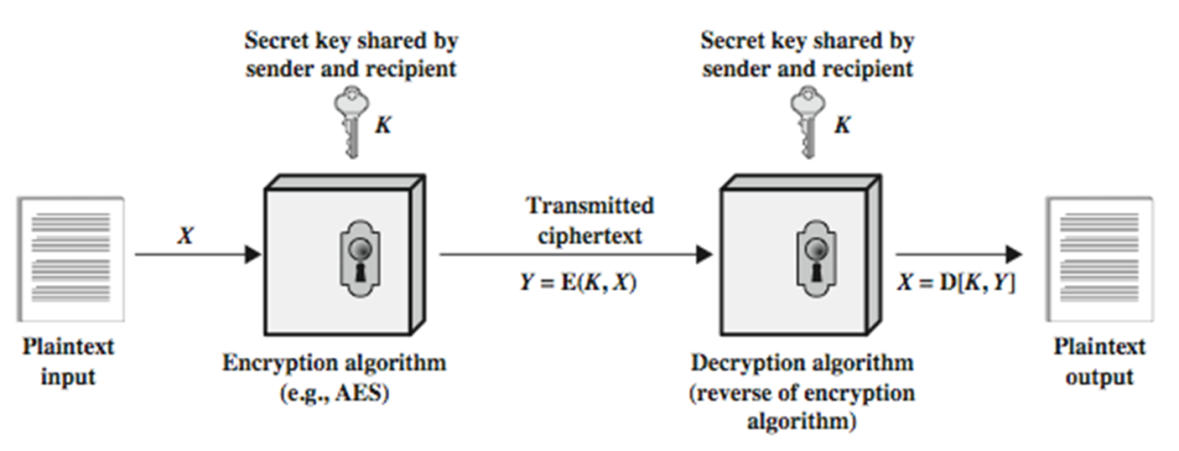
Symmetric Key Cryptography

Slide 27
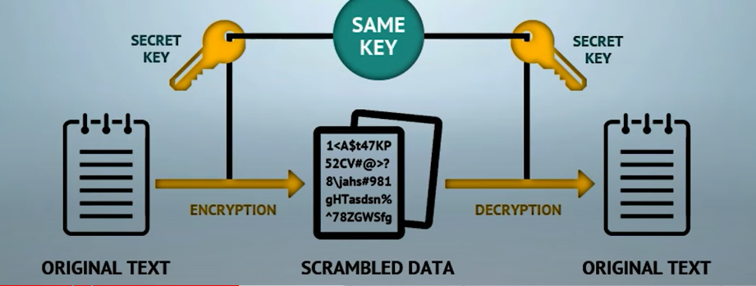
An overview of Symmetric Key Cryptography

Slide 28
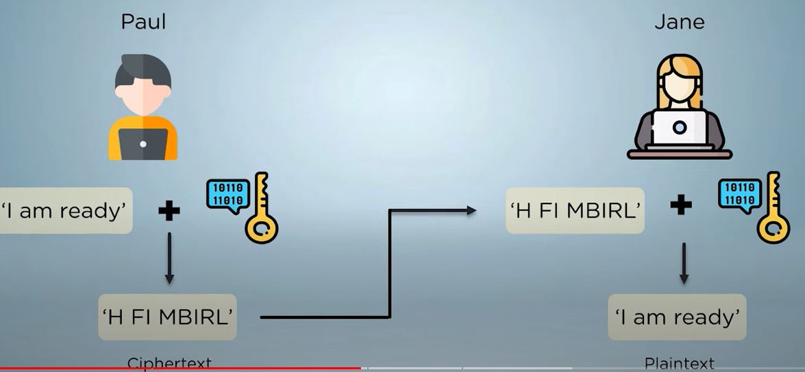
An overview of Symmetric Key Cryptography

Slide 29
An overview of Symmetric Key Cryptography
Symmetric key cryptography involves using the same secret key to encrypt and decrypt the data. The encryption key is shared between the sender and the receiver of the message. This means that both the sender and receiver have the same key, and they use it to encrypt and decrypt messages. The main advantage of symmetric key cryptography is its speed, as it can encrypt and decrypt large amounts of data quickly. However, the main disadvantage is the challenge of securely sharing the key between the sender and receiver without it being intercepted by a third party.
Since the same key is used to encrypt and decrypt, the system is also know as private-key encryption
Symmetric key encryption uses shared secret keys also known as “private-key” encryption
Primarily used for purpose of confidentiality and authentication
Advanced Encryption Standard (AES): This is a widely used symmetric key encryption algorithm that uses a block cipher to encrypt data.
Data Encryption Standard (DES): This is another popular symmetric key encryption algorithm that uses a block cipher. However, DES is considered less secure than AES and is no longer recommended for use.

Slide 30
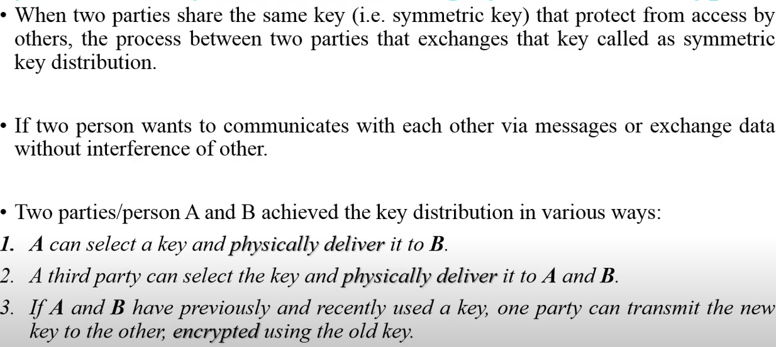
Symmetric key distribution
4. A trusted third party C delivers the key to A and to B using secure channels to A and to B.

Slide 31
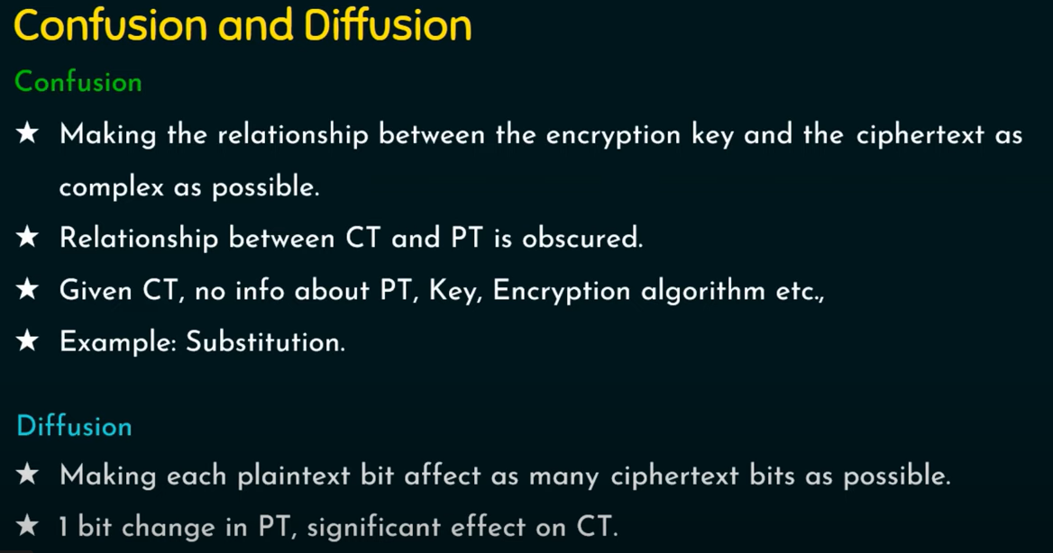
Confusion and Diffusion

Slide 32
Confusion and Diffusion
Diffusion: dissipates statistical structure of plaintext over bulk of cipher text
Confusion: makes relationship between cipher text and key as complex as possible

Slide 33
Feistel Cipher Structure
Horst Feistel devised the Feistel cipher based on concept of invertible product cipher
partitions input block into two halves
process through multiple rounds which perform a substitution on left data half
based on round function of right half & subkey then have permutation swapping halves

Slide 34
Feistel Cipher Structure steps
block size
key size
number of rounds
subkey generation algorithm
round function
fast software en/decryption
ease of analysis

Slide 35
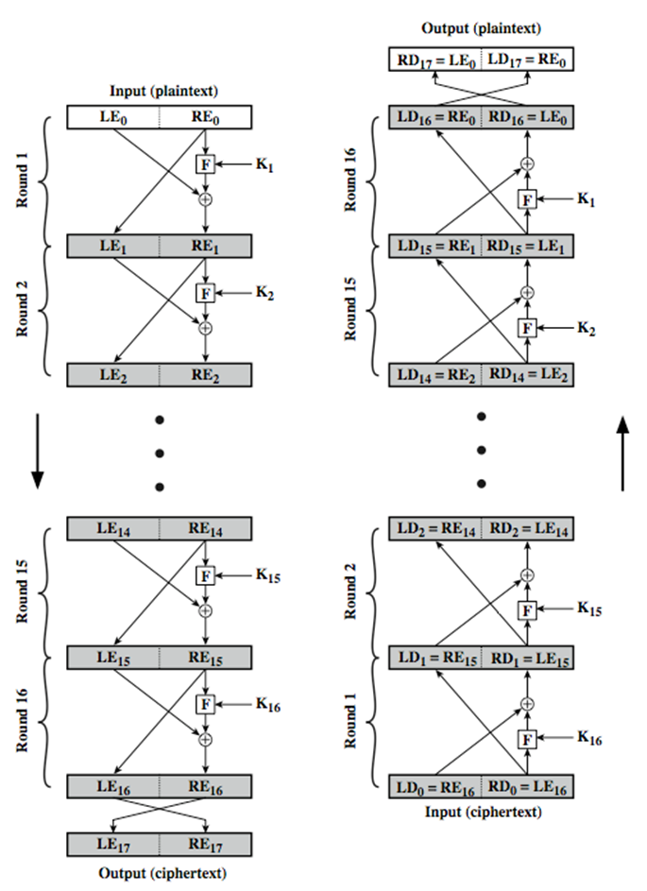
Feistel Cipher Structure

Slide 36
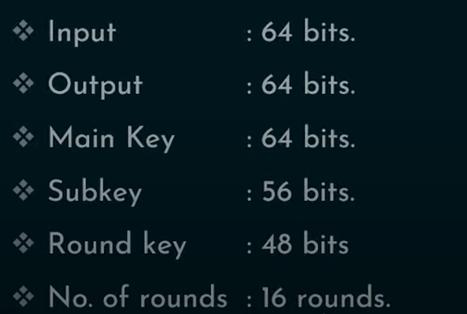
DES(Data Encryption standard) size

Slide 37
DES Algorithm
The Data Encryption Standard (DES):
This algorithm adopted in 1977 by the National Institute of Standards and Technology (NIST). The algorithm itself is referred to as the Data Encryption Algorithm (DEA). For DES, data are encrypted in 64-bit blocks using a 56-bit key. The algorithm transforms 64-bit input in a series of steps into a 64-bit output. The same steps, with the same key, are used to reverse the encryption.
DES encryption algorithm:
The general structure of the DES consists of (1) key schedule, (2) round function and (3) initial and final permutation.
Step1: Plaintext is broken into blocks of length 64 bits.
Step2: The 64-bit block undergoes an initial permutation (IP) using initial permutation IP table, IP(M).
Step3: The 64-bit permuted input is divided into two 32-bit blocks: left (L) and right (R). The initial values of the left and right blocks are denoted L₀ and R₀.
Step4: There are 16 rounds of operations on the L and R blocks. During each round, the following formula is applied:
L_{n} = R_{n-1} R_{n} = L_{n-1} XOR F(R_{n-1},K_{n})

Slide 38
DES Block Cipher
Step5: The function F(.) represents the heart of the DES algorithm. This function implements the following operations:
1-Expansion: The right 32-bit half-block is expanded to 48 bits using the expansion permutation (E) table, E(R_{n-1}).
2-Key mixing: The expanded result is combined with a subkey using an XOR operation. Sixteen 48-bit subkeys (one for each round) are derived from the main key using the key schedule, K_{n} + E(R_{n-1}).
3-Substitution: After mixing in the subkeys, the block is divided into eight 6-bit pieces and fed into the substitution boxes (S-boxes), which implements nonlinear transformation. Each 6-bit piece uses as an address in the S-boxes where the first and last bits are used to address the i^{th} row and the middle four bits to address the j^{th} column in the S-boxes. The output of each S-box is 4-bit length piece. The output of all eight S-boxes is then combined into 32 bit section.
K_{n} + E(R_{n-1}) = B₁B₂B₃B₄B₅B₆B₇B₈
S(Kn + E(Rn-1)) = S1(B₁)S2(B₂)S3(B₃)S4(B₄)S5(B₅)S6(B₆)S7(B₇)S8(B₈)
4-Permutation: The 32 bits outputs from the S-boxes are rearranged using the P-box, F=P(S(K_{n} + E(R_{n-1})))
Step6: The results from the final DES round (i.e., L₁₆ and R₁₆) are recombined into a 64-bit value and rearranged using an inverse initial permutation (IP⁻¹) table. The output from IP⁻¹ is the 64-bit ciphertext block.

Slide 39
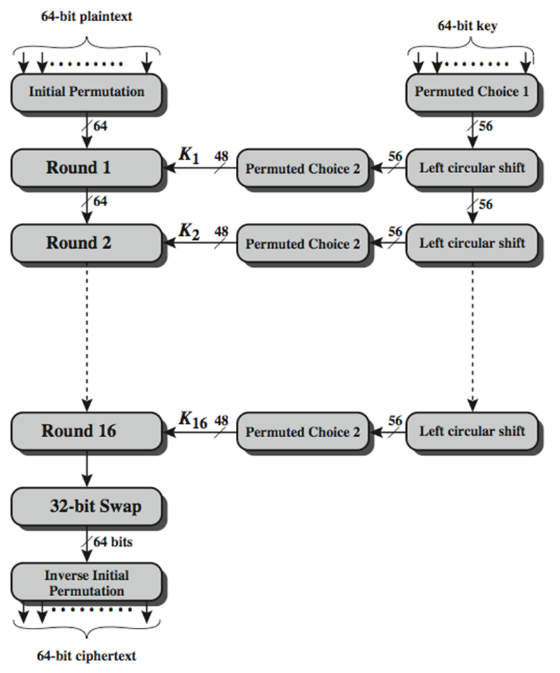
Data Encryption Standard (DES)

Slide 40
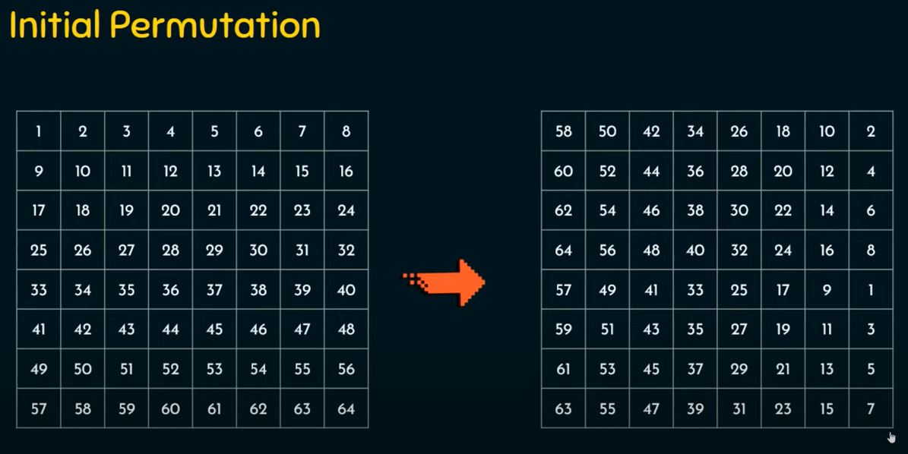

Slide 41
DES Round Structure

Slide 42
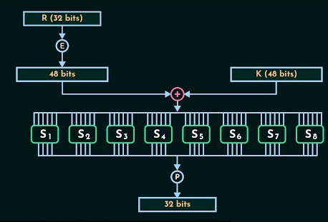
Mangler function F

Slide 43
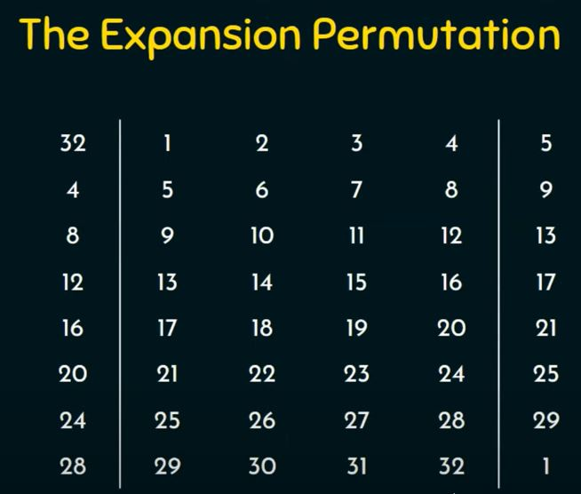

Slide 44
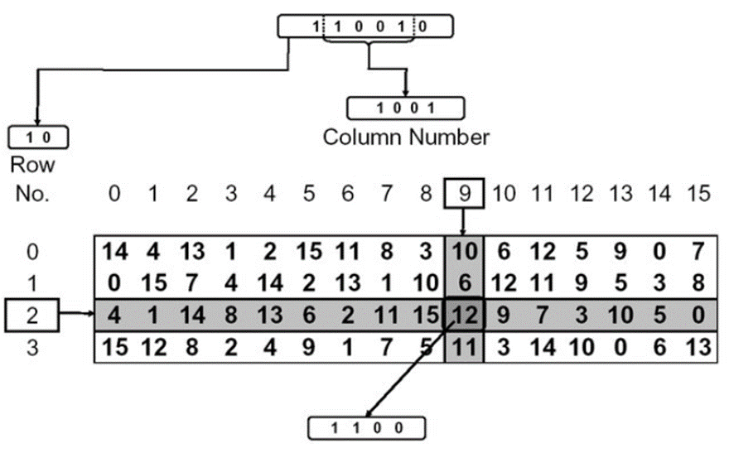
S BOX

Slide 45
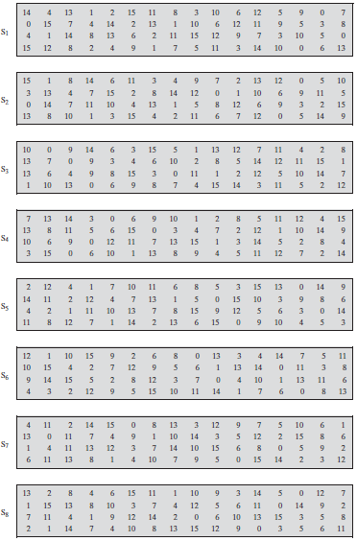
The DES S-Boxes
Tables used in DES key generator

Slide 46
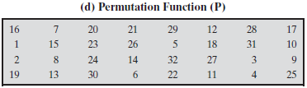

Slide 47
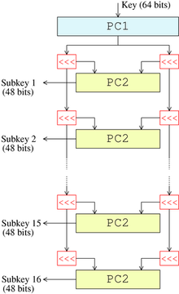
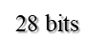
Key schedule (generator):
This algorithm generates the subkeys (K → K₁, K₂…K₁₆).
1- The 56 bits of the key are selected from the initial 64
by Permuted Choice 1 (PC1) table.
2- The 56 bits are divided into two 28-bit halves.
3- In each round, both halves are rotated left by one or
two bits (specified for each round).
4- The 48 subkey bits are selected by Permuted Choice 2 (PC2)
table (24 bits from the left half, and 24 from the right) and used
in each round.
General remarks in the DES:
1- The S-boxes provide the core of the security of DES
and the cipher would be linear, and trivially breakable
without them.
2- The substitution and permutation in the DES provide
confusion and diffusion.
28 bits
56 bits
Key schedule structure

Slide 48
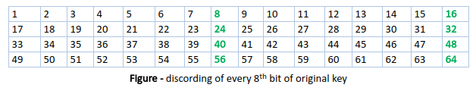
Data Encryption Standard (DES)
DES uses a 56-bit key. Actually, The initial key consists of 64 bits. However, before the DES process even starts, every 8th bit of the key is discarded to produce a 56-bit key. That is bit positions 8, 16, 24, 32, 40, 48, 56, and 64 are discarded.

Slide 49
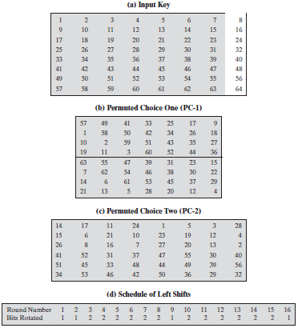

Slide 50
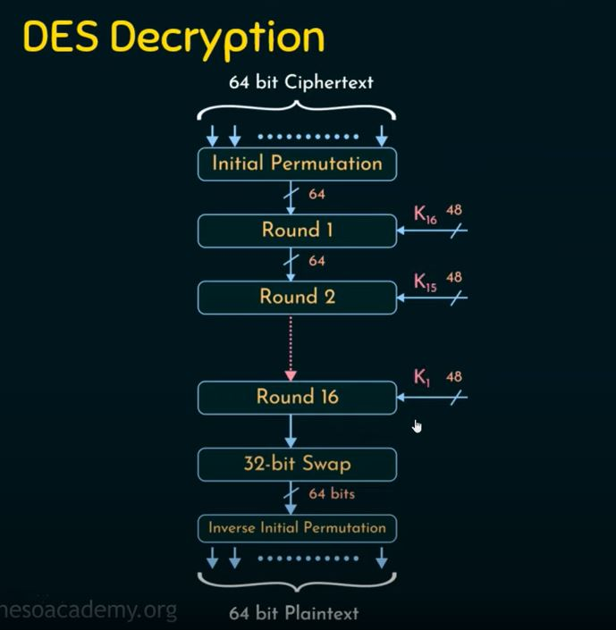

Slide 51
DES Block Cipher
DES decryption :
The decryption algorithm uses the same steps exactly as in the encryption algorithm except that the application of the subkeys is reversed (i.e. in round1 use K₁₆, round2 use K₁₅ and so on).
Security and cryptanalysis:
The two most widely used attacks on block ciphers are linear and differential cryptanalysis. DES is also vulnerable to a brute-force (exhaustive search) attack.
Triple DES:
In cryptography, Triple DES (3DES or TDES), officially the Triple Data Encryption Algorithm (TDEA or Triple DEA), is a symmetric-key block cipher, which applies the DES cipher algorithm three times to each data block.
Therefore, Triple DES uses a "key bundle" that comprises three DES keys, , each of 56 bits.
The encryption algorithm is:
That is, DES encrypt with , DES decrypt with , then DES encrypt with .
Decryption is the reverse:
That is, decrypt with , encrypt with , then decrypt with .
Each triple encryption encrypts one block of 64 bits of data.

